Slide 1
Smart Drawer
PROJECT
AN IOT
FACULTY: Balakrishnan Ramalingam
Aditya Ramdas 21BRS1589
Sanjana Sivakumar 21BRS1649
Himaja Polina 21BRS1660

Slide 2
Problem Statement
Inefficient organization and management of household items can lead to inconvenience and wastage of resources. Traditional drawers lack intelligence and fail to provide timely reminders or monitor item quantities. There is a need for an innovative approach to household automation and organization that addresses these challenges. The aim of this project is to develop smart drawers equipped with reminder systems and weight sensing technologies to improve convenience, optimize inventory management, and enhance overall household automation. By integrating smart features into drawers, we seek to enhance user experience, reduce wastage, and streamline everyday tasks.

Slide 3
Main Objectives
The main objectives of the project include:
Increasing home organization, Smart drawers help in keeping the drawer organized by sending a reminder to the user when the object is not put back in its place. This feature can also be turned off in case the items are not meant to be kept back in its place.
Restocking, Smart drawers update the users about the status of its containers based on its weight. The capacity of the container is derived based on predefined maximum weight and current weight, which is updated regularly and sent to the user. This makes it easier for the user to restock the containers.

Slide 4
Apparatus Required
Force Sensors
Arduino Uno
Makeshift “Drawer” (shoebox)
10k ohm Resistors

Slide 5
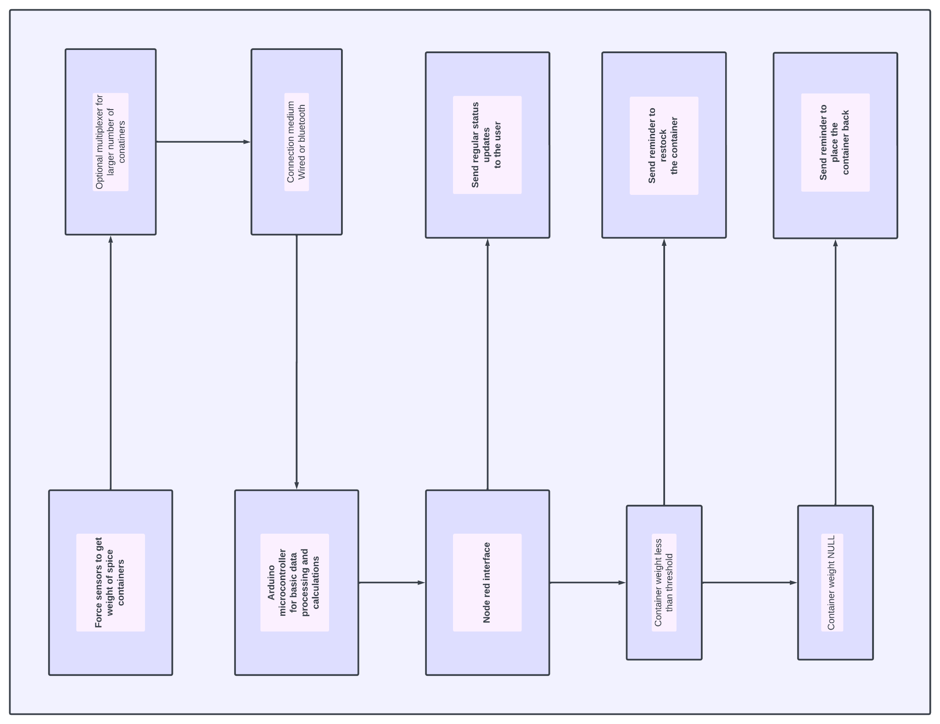
Block Diagram

Slide 6
PROTOTYPE
tinkercad
The process of creating the prototype was challenging, yet enjoyable. With prior knowledge to the working principle of Tinkercad, the circuit was made relatively easily. The hardest part was the implementation of force sensors in Tinkercad. Along with trying to understand how the force sensor worked, the coding had to be tweaked in order to convert the reading from newtons to grams. One obstacle that was overcome was the alerts given by the circuit. Initially, the alerts only occurred when the force was 0 newtons. However, by changing small parts of the code, we were able to send alerts when the force was above a specific value.

Slide 7
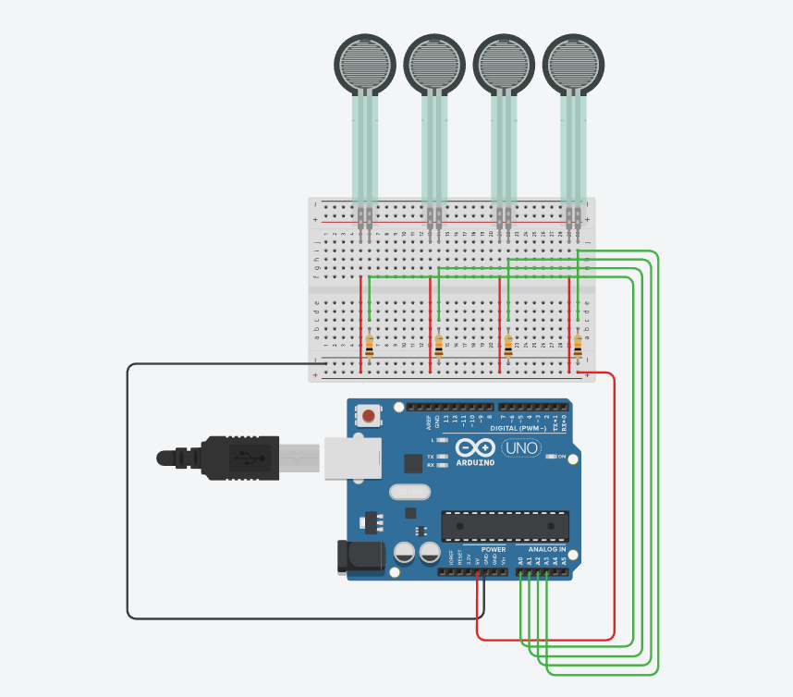
Code
Circuit Diagram
const int numSensors = 4;
const float threshold = 10.0;
const int reminderTime = 10;
unsigned long timer[numSensors];
bool isBoxPresent[numSensors];
void setup() {
Serial.begin(9600);
for (int i = 0; i < numSensors; i++) {
pinMode(i, INPUT);
timer[i] = millis();
isBoxPresent[i] = true;
}
}
void loop() {
for (int i = 0; i < numSensors; i++) {
float forceValue = analogRead(i) * 0.0228;
if (forceValue < threshold && isBoxPresent[i]) {
//
Serial.print("Restock Box ");
Serial.println(i);
isBoxPresent[i] = false;
timer[i] = millis();
}
else if (forceValue >= threshold && !isBoxPresent[i]) {
Serial.print("Box ");
Serial.print(i);
Serial.println(" Restocked");
isBoxPresent[i] = true;
}
//
if (!isBoxPresent[i] && millis() - timer[i] >= reminderTime * 1000) {
Serial.print("Put Box ");
Serial.print(i);
Serial.println(" Back");
timer[i] = millis();
}
}
delay(100);
}

Slide 8
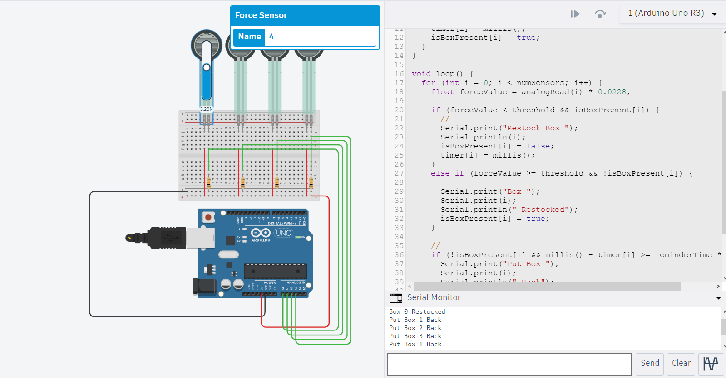
OUTPUT
of prototype

Slide 9
EXECUTION
arduino IDE

Slide 10
Executing using Arduino
PROCEDURE:
Create the circuit using a 10k ohm resistor and force sensor.
Connect this circuit to the computer.
Open Arduino IDE and write the code.
Go to tools and select the correct port.
Verify and upload the code.
Observe the output in the Serial Monitor.

Slide 11
Executing using Arduino
For this experiment, we use a ketchup bottle to test if the Smart Drawer can detect it’s weight. The thresholds in the code had to be adjusted in order for the weight to be correctly detected by the sensor. In order for the weight of the ketchup bottle to be detected by the sensor, we put erasers at the bottom of the box, where the sensor is, and put a cardboard square on top of the erasers (like a false bottom). We place the ketchup bottle on the top of the ‘false bottom’.
When the sensor detects a weight below the mentioned threshold, a message appears on the Serial Monitor “Put Box 0 Back”, and after a time delay, “Restock Box 0”. When the sensor detects a weight above the mentioned threshold, a message appears on the Serial Monitor “Box 0 Restored”.

Slide 12
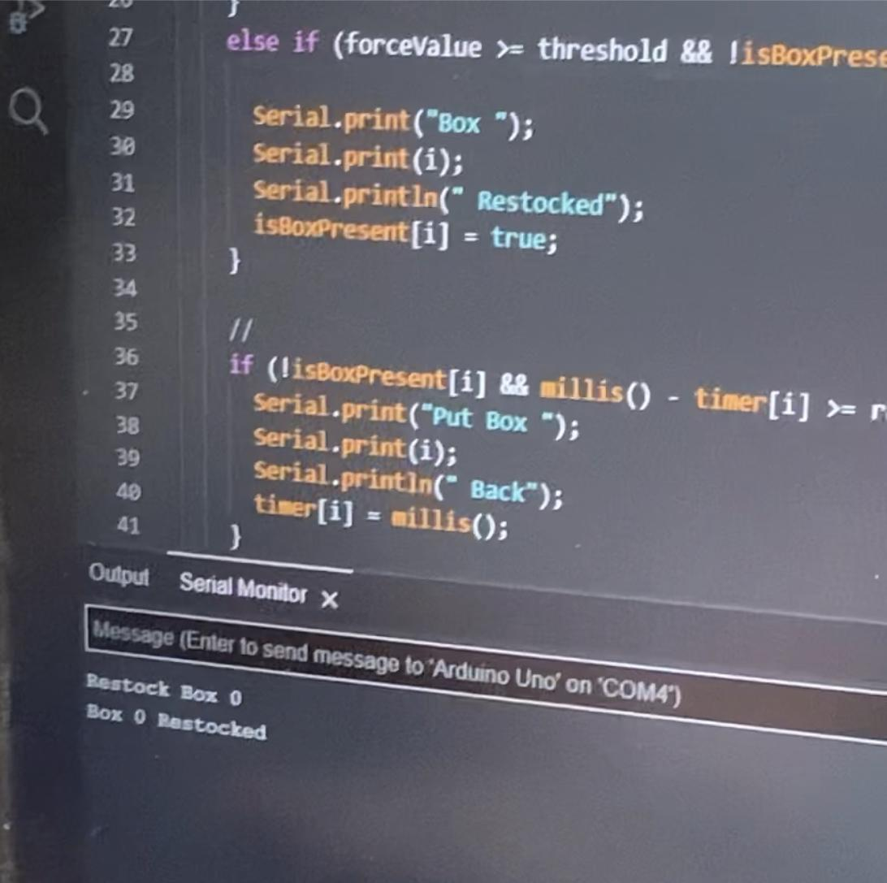
OUTPUT
of arduino IDE

Slide 13
EXECUTION
node-red

Slide 14
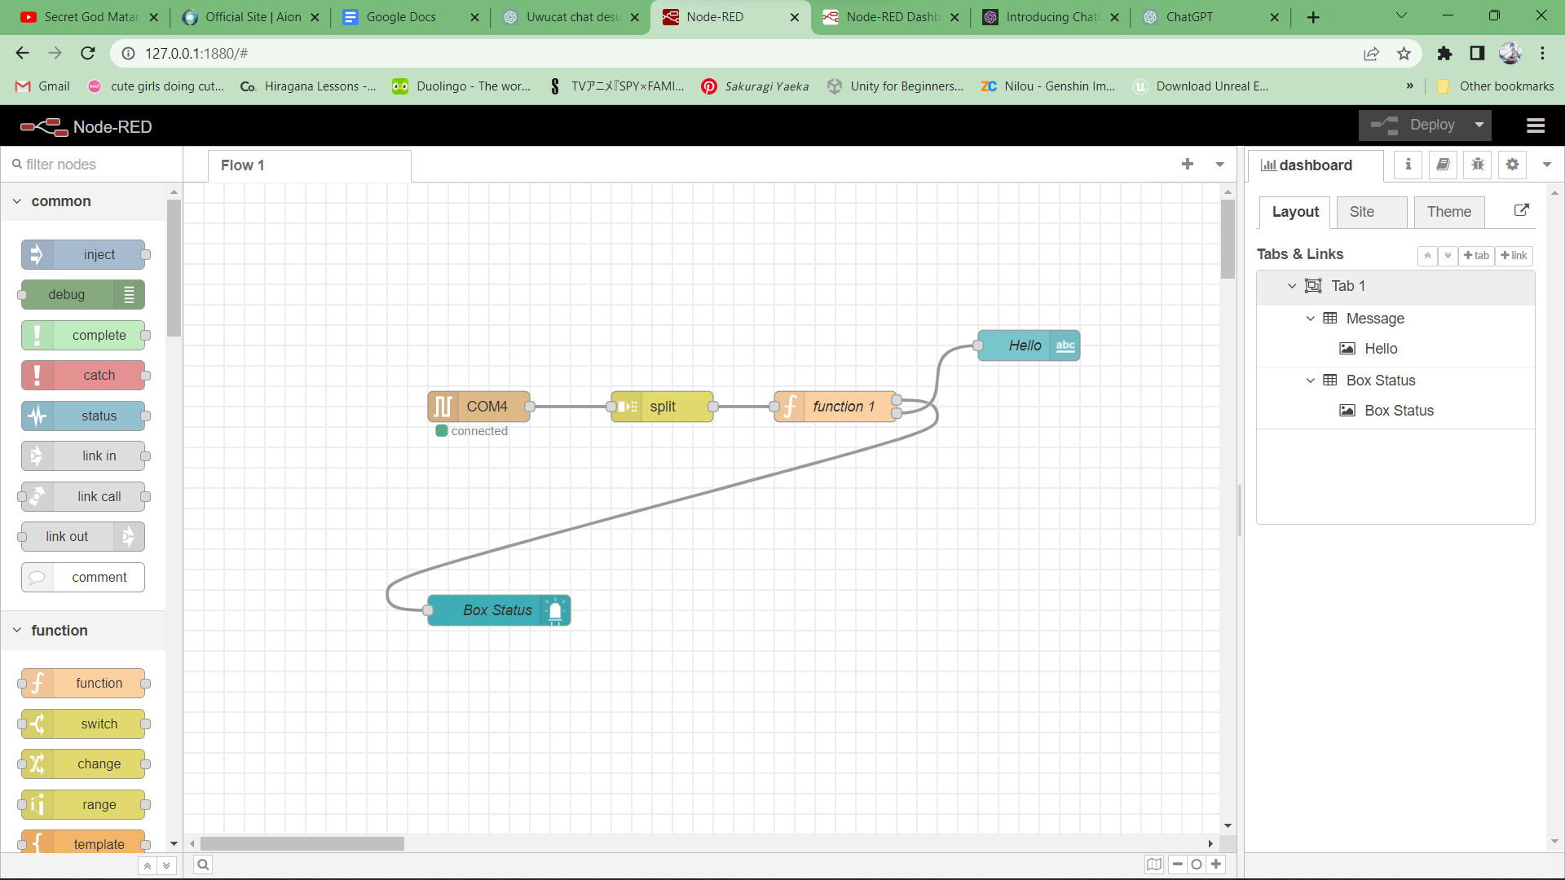
Block/Circuit Diagram

Slide 15
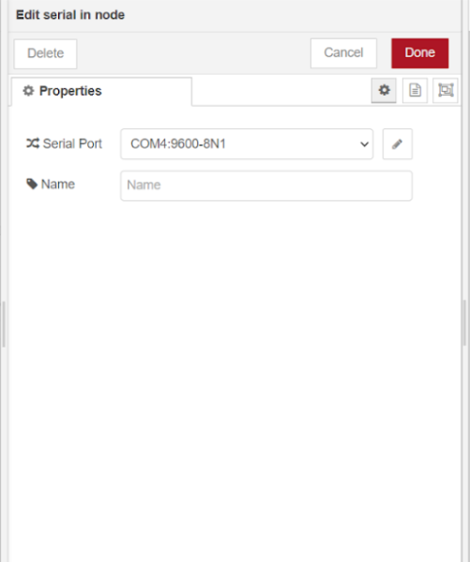
Serial Node

Slide 16
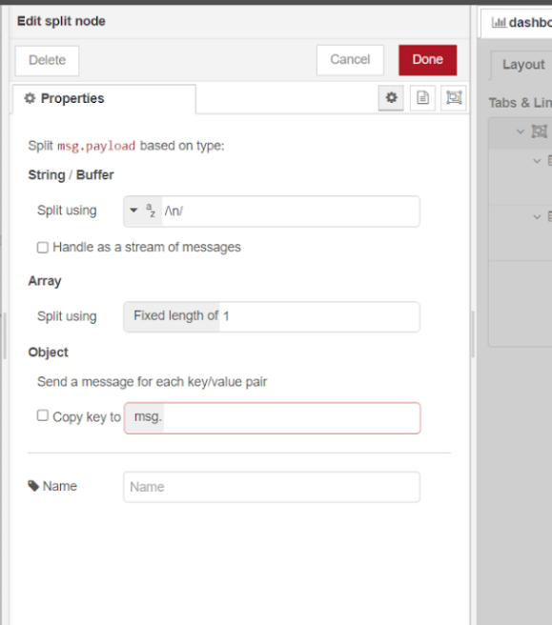
Split Node

Slide 17
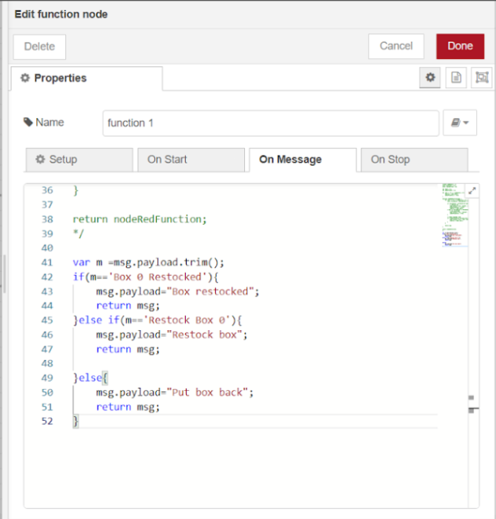
Function Node

Slide 18
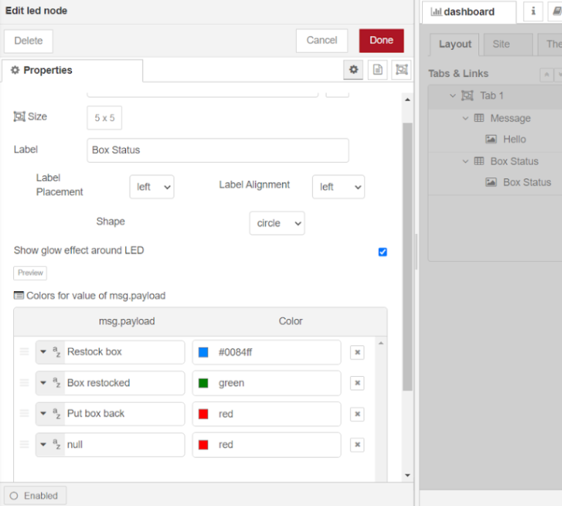
LED Node

Slide 19
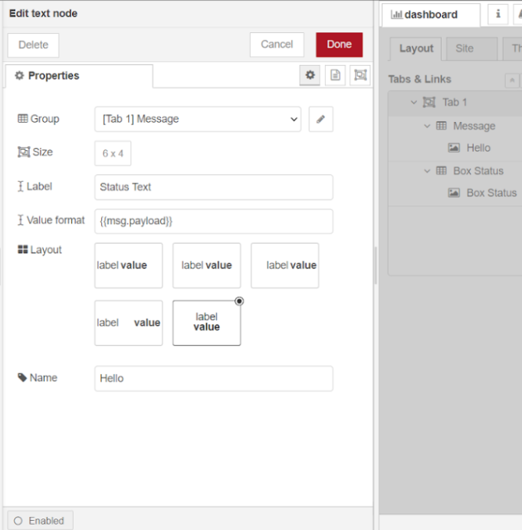
Text Node

Slide 20
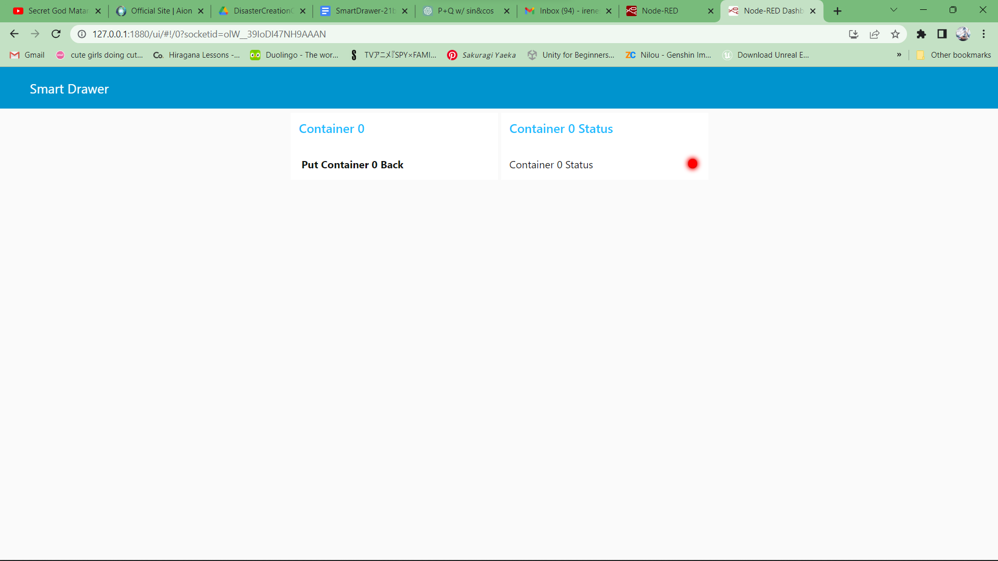
Case 1

Slide 21
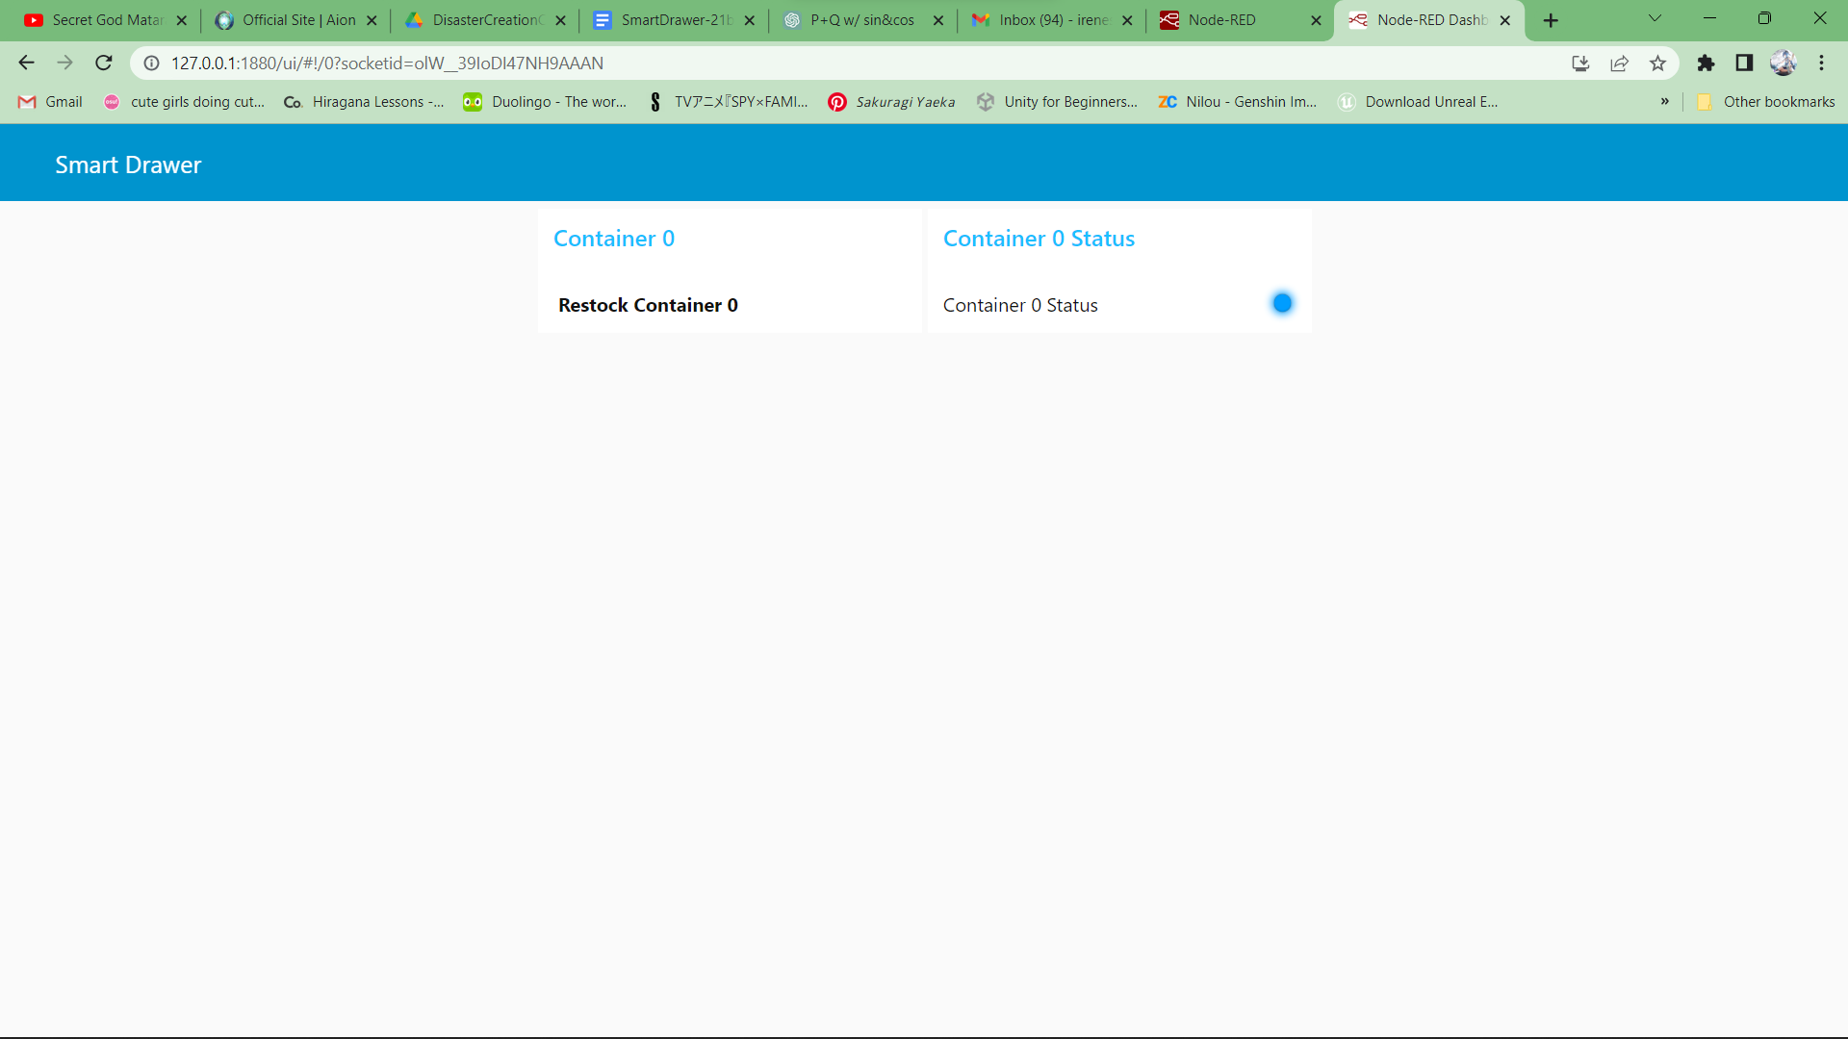
Case 2

Slide 22
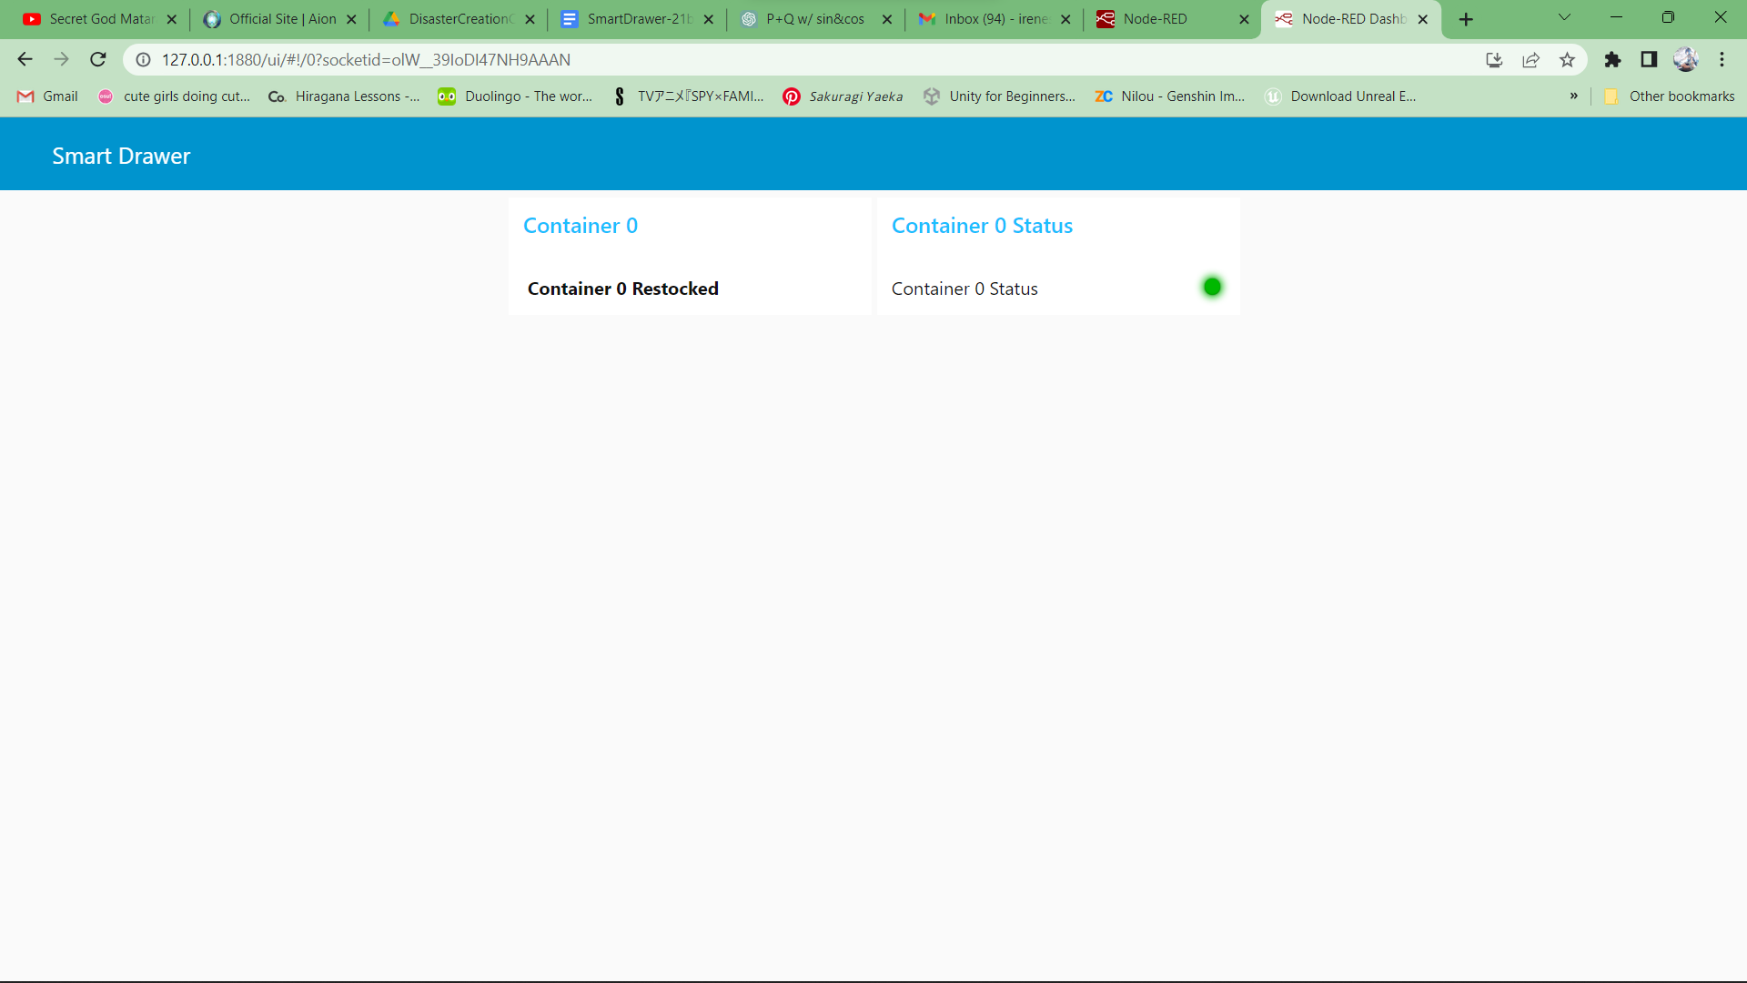
Case 3

Slide 23
FINAL PROJECT

Slide 24
Final Project
Apparatus used: 3 force sensors, 3 10k resistors and one Arduino Uno board
There are three compartments, in each compartment one force sensor is placed in. Along with the additional compartments/sensors, we have added a temperature sensor to sense the temperature of the environment of the Smart Drawer.

Slide 25
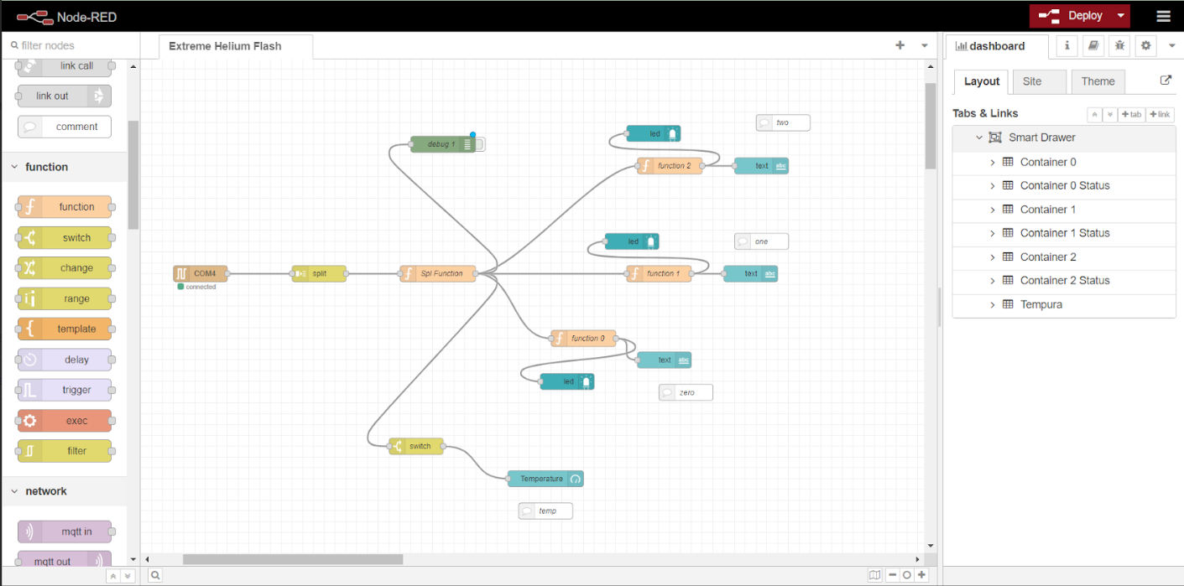
Node-Red

Slide 26
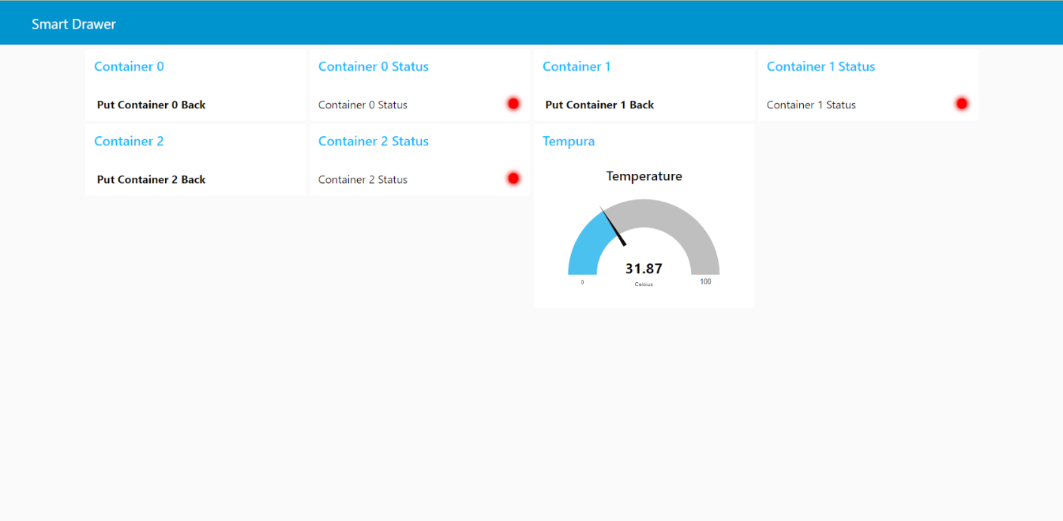

Slide 27
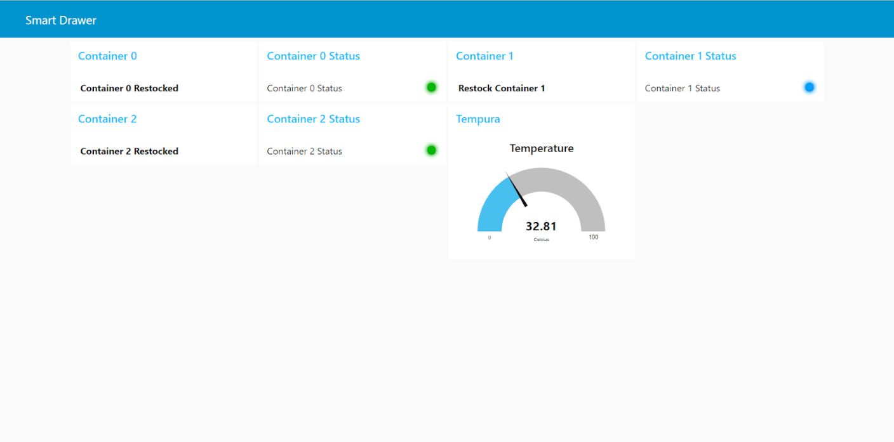

Slide 28
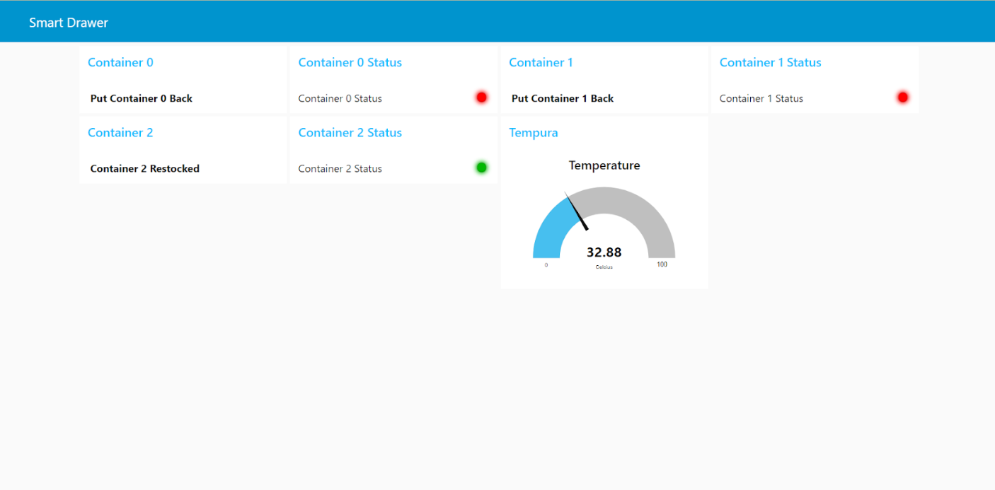

Slide 29
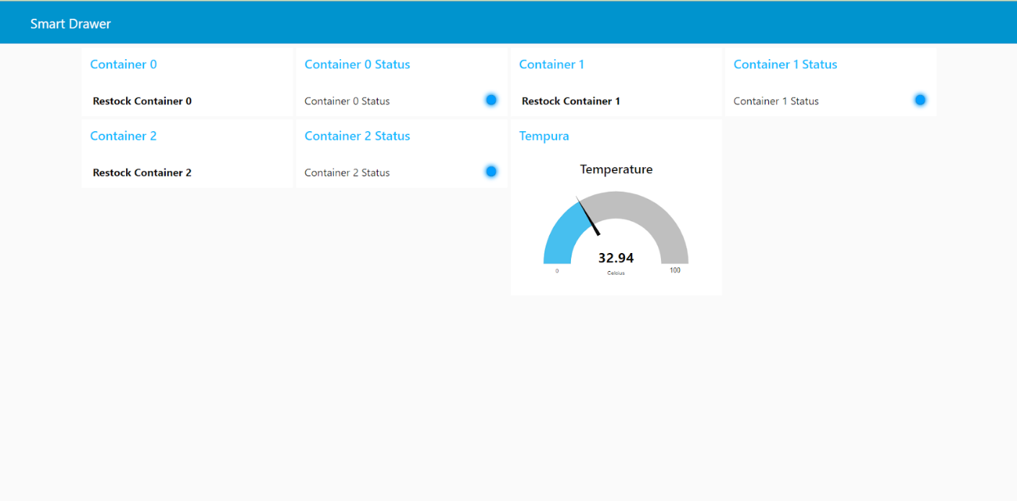

Slide 30
Discussion
By incorporating force sensors in each of its three compartments, the Smart Drawer can accurately detect the weight of containers placed inside. When a container reaches a weight above the predefined threshold value, the system notifies the user that the compartment is restocked, indicated by a green LED.
Conversely, if the weight of a container falls below the threshold value or if it is removed from the compartment, the force sensor detects this change and triggers a message to the user, prompting them to put the object back. In this scenario, the LED turns blue, indicating the need for restocking. If the container remains unattended for a certain time delay, the system intensifies the message to the user, urging them to restock. The LED color changes to red to signify the criticality of the situation.
Additionally, the Smart Drawer also features a temperature recording function, allowing the user to monitor the environmental conditions in which the drawer is placed. This information can be valuable for storing temperature-sensitive items or ensuring appropriate storage conditions.

Slide 31
Conclusion
In conclusion, the Smart Drawer project offers a convenient and efficient solution for managing inventory and ensuring timely restocking. The Smart Drawer project combines the use of force sensors, LED indicators, and temperature monitoring to provide an efficient and user-friendly system for inventory management and organization. It helps users stay informed about the stock levels, promotes timely restocking, and ensures the preservation of temperature-sensitive items. This Smart Drawer also accounts for the time it would take for the user to use the container and keep it back. This time delay can be changed according to the preference of the user. It can be personalised for different users and situations.

Slide 32
Thank you

